Slide 1

Web Forms

Slide 2
Web Forms
All our web pages thus far have had a one-way flow of information, from us to our web visitors. Now we'll see how our visitors can send information back to us via a web form. There are a number of reasons we might want our audience to fill out a form on our site:
Survey or poll
Contact us
Sign up for an email newsletter
Register for an event
Submit comments or feedback about our site
Log in to a members-only section of the site
Once the information in a web form is submitted, a web server is required to process the information. That is an advanced topic, so we'll just focus on the designing of the web form, not the processing.

Slide 3
The <form> Element
To create a web form on a page, we use the opening and closing <form> and </form> tags:
<form method="post" action="process.php">
<!-- All form content goes here -->
</form>
The method attribute determined in which format the submitted data will be sent. The two possible values are "post" and "get".
The action attribute declares which file will receive and process the data once submitted. This will be a file written in a scripting language, such as PHP or ASP.
All elements of the form must reside within the form element. As we have not added any elements to this example form yet, nothing would display on the page.

Slide 4
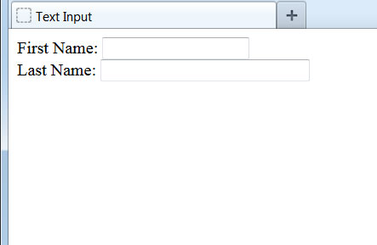
Text Box
Let's begin adding some form elements. The most versatile component of a form is the <input> element. Here we are adding two text fields:
<form method="post" action="process.php">
First Name: <input type="text" size="20" name="firstname" /><br />
Last Name: <input type="text" size="30" name="lastname" /><br />
</form>
The type attribute determines which kind of input the field will be. A value of "text" creates a single-line text box with the size attribute determining the width in characters.
We must define the name attribute and supply a unique value for each element of a web form that collects data from the user. This will be used later by the web server.

Slide 5
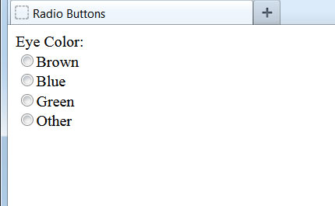
Radio Buttons
By changing the type attribute to "radio", we can create a set of options, of which the user can choose only one:
<form method="post" action="process.php">
Eye Color:<br />
<input type="radio" name="eye" value="brown" />Brown<br />
<input type="radio" name="eye" value="blue" />Blue<br />
<input type="radio" name="eye" value="green" />Green<br />
<input type="radio" name="eye" value="other" />Other<br />
</form>
Notice that each radio option has its own input element, with the identical name attribute. Only the value attribute differs.
These are known as radio buttons because older cars used to have a set of buttons to press in for different radio stations. When a new button was pressed in, the old button would pop out.

Slide 6
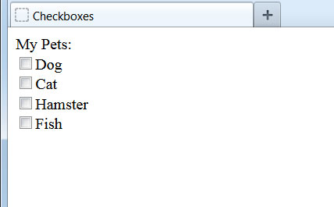
Checkboxes
Another possible type attribute is "checkbox", which differs from radio buttons in that none, some, or all of the options can be selected:
<form method="post" action="process.php">
My Pets:<br />
<input type="checkbox" name="pets" value="dog" />Dog<br />
<input type="checkbox" name="pets" value="cat" />Cat<br />
<input type="checkbox" name="pets" value="hamster" />Hamster<br />
<input type="checkbox" name="pets" value="fish" />Fish<br />
</form>
Again, each checkbox option has its own separate input element. The matching name attribute is how we indicate that the options are part of the same list.
If we had another set of checkboxes on the form, they would have a different name attribute value.

Slide 7
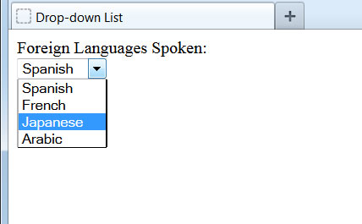
Drop-down List
We can use the select and option elements together to create a drop-down list of options on our form:
<form method="post" action="process.php">
Foreign Languages Spoken:<br />
<select name="language">
<option value="spanish">Spanish</option>
<option value="french">French</option>
<option value="japanese">Japanese</option>
<option value="arabic">Arabic</option>
</select>
</form>
The name attribute is applied to the select element, not the individual option elements.
Drop-down lists are useful, as they can save us a lot of real estate on the screen, especially when there are a lot of options from which to choose.

Slide 8
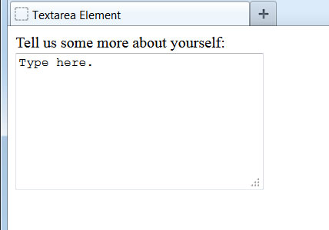
Large Text Box
If a single-line text box isn't big enough, we can use the textarea element to present a larger, expandable box that can hold a lot of text:
<form method="post" action="process.php">
Tell us some more about yourself:<br />
<textarea name="more" rows="8" cols="30">
Type here.
</textarea>
</form>
The width and height of the box that displays on the web page is controlled by the rows and cols attributes, respectively.
Whatever text is placed between the opening and closing <textarea> tags will display in the box itself when the page first loads. This could serve, for example, to provide the user with more instructions.

Slide 9

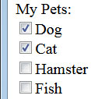
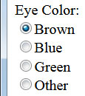

Preselecting Options
Sometimes, we want to prefill or preselect form data for our visitors. We can do so by using these special attributes:
First Name: <input type="text" size="20" name="firstname" value="John" />
...
<input type="radio" name="eye" value="brown" checked="checked" />Brown
...
<input type="checkbox" name="pets" value="dog" checked="checked" />Dog
<input type="checkbox" name="pets" value="cat" checked="checked" />Cat
...
<option value="french" selected="selected">French</option>

Slide 10
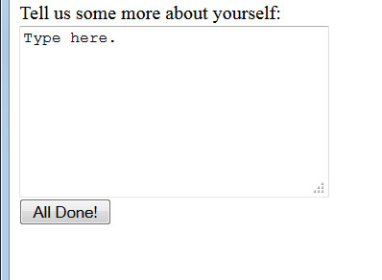
Submit Button
Once we've built all the fields for our web visitor to fill out, we need to provide them a way to submit their answers to us. We do this by including a button for them to click:
...
</textarea><br />
<input type="submit" value="All Done!" />
</form>
Whatever text we place in the value attribute will display on the button itself.
Once the submit button is clicked, the page will gather all the data from the form and send it to the file indicated in the opening <form> tag for processing.

Slide 11
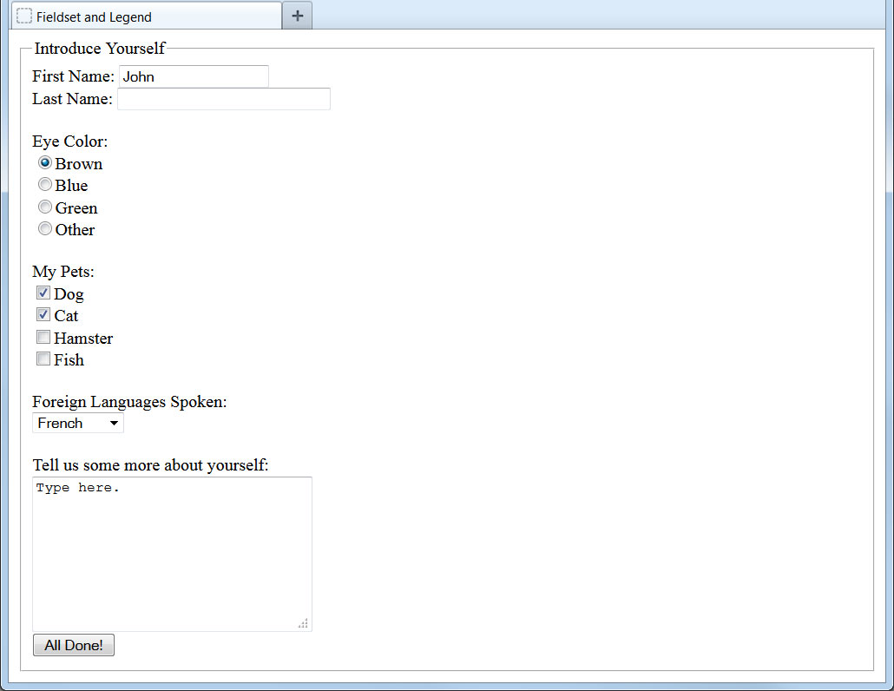
Fieldset and Legend
We can group form fields together and caption them using the <fieldset> and <legend> elements:
<form method="post" action="process.php">
<fieldset>
<legend>Introduce Yourself</legend>
...
</fieldset>
</form>
The fieldset will draw a line surrounding the form elements within it.
We can caption the group of form fields with whatever text we place within the opening and closing <legend> tags.
Multiple fieldset and legend pairs can be used within a single form element. For example, they could be used to set apart and title different sections of the form.

Slide 12
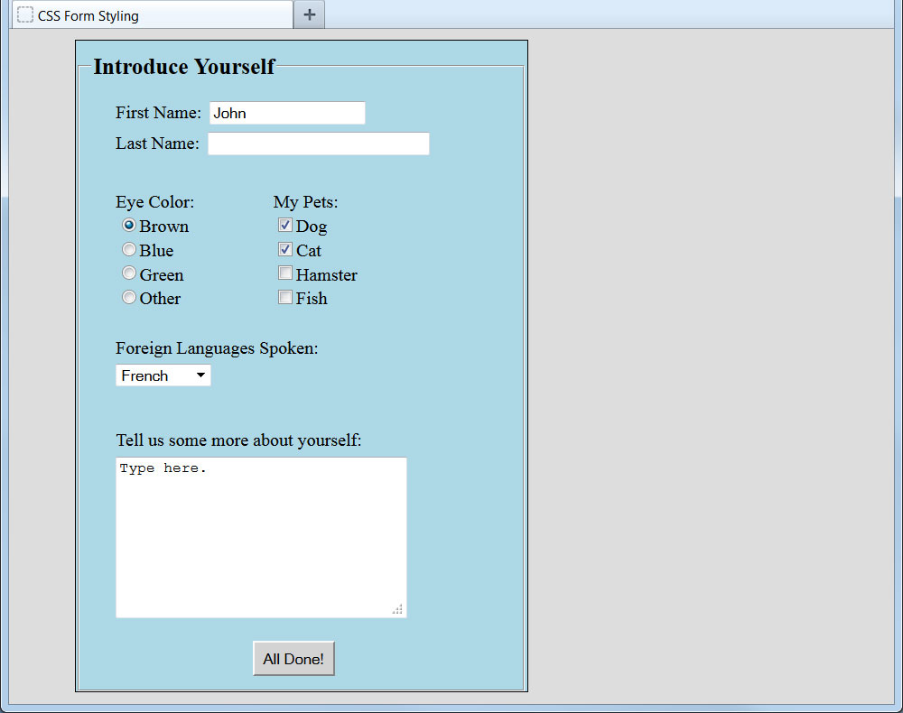
CSS Form Styling
With a dash of CSS styling, we can make our form more presentable to our visitors:

